Slide 1




Module Name - Dynamic Programming
Topic Name: Edit distance Problem
EditEdit MasterMaster texttext stylesstyles

Slide 2

Today’s Agenda
Edit Distance Problem
Coding Assessment

Slide 3

Edit Distance
Now, let’s quickly go through another famous DP problem, edit distance.
According to Wikipedia, edit distance is a way of quantifying how dissimilar two strings are to one another.
And this is done by counting the minimum number of operations required to transform one string into the other.

Slide 4
Edit Distance
Now, if you have to transform one string into another, you generally need to consider three operations:
1. Insertion
2. Deletion
3. Replacement
For example, if you want to transform “ishan” to “nishant”, the brute force approach would include —
i -> n,
s -> i,
h -> s,
a -> h,
n -> a.
And then, you should insert n and t at the end of the string.

Slide 5

Edit Distance
But, this approach would require seven operations, and that is clearly not the minimum.
The minimum number of operations required would be two. It is possible by inserting ‘n’ at the beginning, and ‘t’ at the end.

Slide 6
Edit Distance
Let’s start with the solution approach.
We will start by creating our matrix E which will contain edit distance values of the substrings.
Notice that we will need to create an extra row and column if either of the strings are empty.

Slide 7
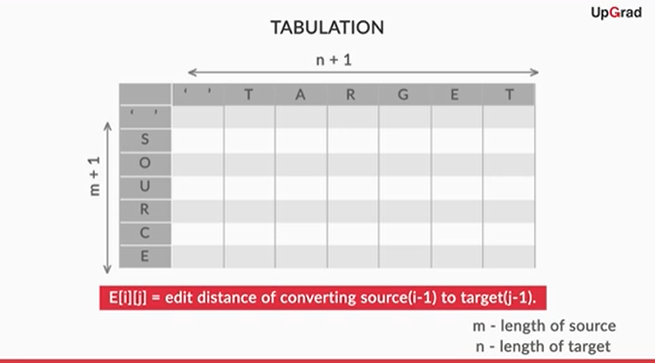
Edit Distance

Slide 8
Edit Distance
Unlike other problems we have solved so far, this time we will have four choices:
1. Insert last character of target, that is target[n-1], in the last position of source.
editDistance(m, n) = 1 + editDistance(source(m), target(n-1))
1 is added because of the insertion operation.
Eg. E(red, redo)= 1+ E(red, red)
2. Delete the last character, that is source[m-1], from source.
editDistance(m, n) = 1 + editDistance(source(m-1), target(n))
1 is added because of the deletion operation.
Eg. E(redo, red)= 1+ E(red, red)

Slide 9
Edit Distance
3. Replace the last character of source, that is source[m-1], with the last character of target, that is target[n-1].
editDistance(m, n) = 1 + editDistance(source(m-1), target( n-1))
1 is added because of the replace operation.
Eg. E(redx, redy)= 1+ E(red, red)
4. Do nothing since the last character of source is the same as the last character of target.
editDistance(m, n) =0 + editDistance(source(m-1), target(n-1))
No cost, because no operation was performed
Eg. E(red, red)= 0+ E(re, re)= 0+ E(r, r)= 0+ E(‘ ’, ‘ ’)= 0

Slide 10
Edit Distance
Firstly, we need to fill out the base cases(row 1 and column 1).
The first complete column indicates the base case, which shows that target is an empty string.
So, in that case, the transformation will take place after deleting all the characters from the source string, and edit distance will be the length of the source string.
Hence, for i = 0 to m, E[i][0] = i (all deletions).
Similarly, for j = 0 to n, E[0][j] = j (for all insertions).

Slide 11
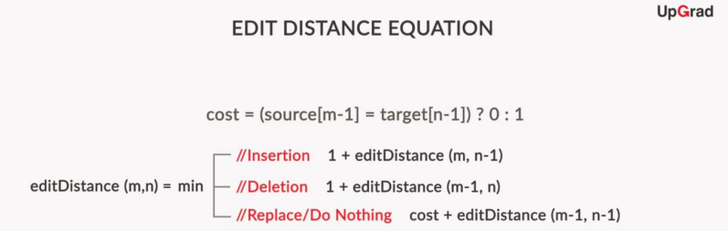
Edit Distance
And using the given edit distance equation, we populate our matrix; you can follow a bottom-up approach to fill the matrix — from the very first cell to the final destination cell.
Similarly, here you can start from E[0][0] and compute the edit distance value for each cell of the matrix until you reach E[m][n].

Slide 12
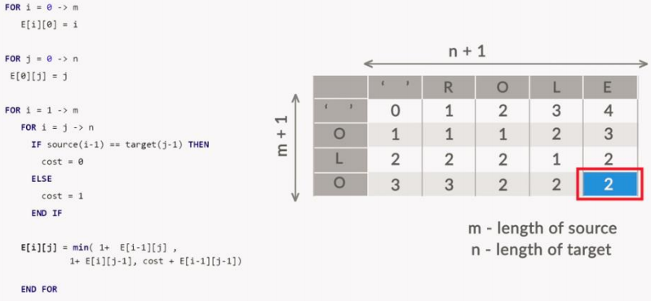
Edit Distance
Let’s understand the entire algorithm now with a pseudocode and example:

Slide 13
Edit Distance
And at last, let’s quickly go through the java code for edit distance problem:
int sourceLength = source.length();
int targetLength = target.length();
Integer[][] E = new Integer[sourceLength+1][targetLength+1];
//filling out base cases
for (int i = 0; i <= sourceLength; i++ ){
E[i][0] = i;
}
for (int j = 0; j <= targetLength; j++ ){
E[0][j] = j;
}

Slide 14
Edit Distance
for (int i = 1; i <= sourceLength; i++){
for (int j = 1; j <= targetLength; j++){
int cost=source.charAt(i-1) == target.charAt(j - 1) ? 0 : 1;
E[i][j] = Math.min( Math.min( E[i-1][j-1] + cost, E[i][j-1] + 1), E[i-1][j] + 1); }}
return E[sourceLength][targetLength];
And this ends our java code and also the module of Dynamic Programming.
But before you go, here’s one last question for you so that you can practice your newly learnt skills.

Slide 15
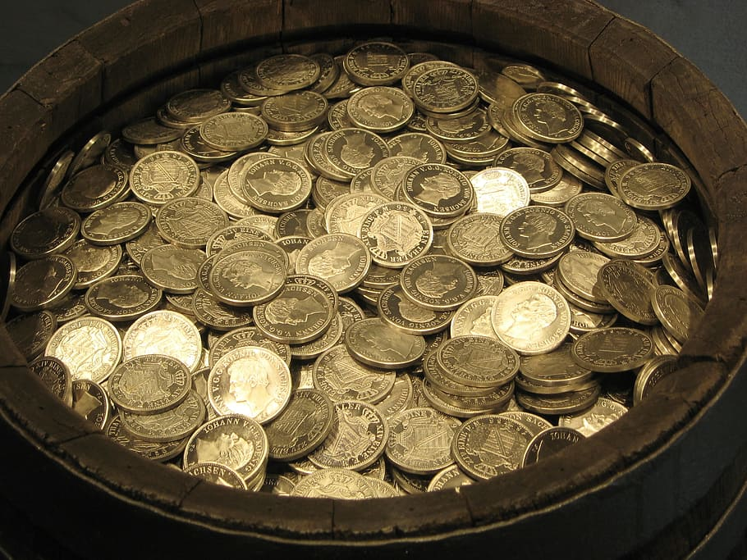
Student Assignment
Let’s add a small change in our coin exchange problem.
Instead of finding the minimum number of coins needed to pay for an amount, let's find out the total number of ways a change can be made.
So, let’s say you have an unlimited supply of coins in four denominations —
d₁=1,
d₂=5,
d₃=7,
d₄=10.

Slide 16
Student Assignment
If you are asked to make an amount of 11, you can use the following combinations:
11 coins of value 1
10 + 1
7 + 1 + 1 + 1 + 1
5 + 1 + 1 + 1 + 1 +1+1
5 + 5 + 1
Thus, you can pay for 11 currency values in 5 ways

Slide 17
Student Assignment
Problem Statement :-
Given an unlimited supply for few denominations [1,5,7,10] and an amount n, your code should output the number of ways the amount can be paid from the given denominations.
The input should have the amount n of which you have to find the number of ways.
The output should print the value of number of ways the amount can be paid.

Slide 18
Student Assignment
Sample Input
20
Sample Output
15
Sample Input
12
Sample Output
6
Happy Coding!!!

Slide 19
Key Takeaways
It’s time to answer the key takeaways from this lesson.
Follow the path to answer:
Module:- Dynamic Programming
Session:- Industry Demonstration
Segment:- Summary
OR
Follow the link:
<https://learn.upgrad.com/v/course/439/session/39884/segment/214087>

Slide 20

Thank You!
Happy learning!
#LifeKoKaroLift

